Slide 1
Factor Analysis
Extracting Hidden Factors in Multivariate Data

Slide 2
Contents
01
02
What is Factor Analysis
Factor Analysis – Statistical Model
03
04
Common Factor and Unique Factor
Factor Analysis Assumptions
05
05
06
Estimation of Factor Loadings
Interpretation of Factor Loadings
07
08
Rotation of Factors
Factor Scores
09
Factor Analysis in Python

Slide 3
Factor Analysis
Factor Analysis is primarily used for,
It is an interdependence technique: No distinction between dependent and independent variables (Also called as Unsupervised Method)
ysis
Data Reduction
The purpose of data reduction is to replace original variables with a smaller number of uncorrelated variables
Structure Detection
The purpose of structure detection is to examine the underlying (or latent) relationships between the variables
or

Slide 4
Statistical Model
Each variable is expressed as a linear combination of factors
The factors are some common factors plus a unique factor
The factor model is represented as:
X_{i}=l_{i1}F₁ + l_{i2}F₂ + l_{i3}F₃ + - - - - + l_{im}F_{m} + u_{i} + e_{i}
where,
      l_{ij} : Loading of variable i on common factor j
      F_{j} : Common factor j
      u_{i} : Mean of variable i
      m : Number of common factors
      e_{i} : Specific factor
The model looks similar to linear regression but factors are unobservable

Slide 5
Statistical Model – Five Variables and Two Common Factors
Each variable is expressed as a linear combination of two factors
The factor model is represented as:
X₁ –u₁ =l₁₁F₁ + l₁₂F₂ + e₁
X₂ –u₂ =l₂₁F₁ + l₂₂F₂ + e₂
X₃ –u₃ =l₃₁F₁ + l₃₂F₂ + e₃
X₄ –u₄ =l₄₁F₁ + l₄₂F₂ + e₄
X₅ –u₅ =l₅₁F₁ + l₅₂F₂ + e₅
F₁ and F₂ are common factors
e's are specific factors
Each variable loads on two common factors

Slide 6
Statistical Model – Five Variables and Two Common Factors
The common factors themselves can be expressed as linear combinations of the observed variables.
F_{i} = W_{i1}X₁ + W_{i2}X₂ + W_{i3}X₃ + . . . + W_{ik}X_{k}
where,
F_{i} : Estimated score of i^{th} factor
W_{i} : Weight or factor score coefficient
k : Number of variables

Slide 7
Common Factor and Unique Factor
Common Factor
It is an abstraction, a hypothetical construct that affects some or all observed variables
We want to estimate the common factors that contribute to the variance in our variables
Example: Athletics performance can be thought of as combination of 'speed' and ‘stamina'
Unique Factor
It is a factor that contributes to the variance of only one variable
We want to exclude these unique factors from our solution
The unique factors are unrelated to one another and unrelated to the common factors

Slide 8
Factor Analysis Assumptions
For the factor analysis model to be valid and produce interpretable results, certain statistical assumptions must be satisfied. When these conditions hold, we have what's called an Orthogonal Factor Model.
Assumption 1
Independence: Fj and ei are independent
The common factors and unique factors must be uncorrelated with each other. This ensures that the variance in our variables can be cleanly partitioned between common and unique sources.
Assumption 2
Factor Properties: E(Fj) = 0, Cov(Fj, Fk) = 0 for j ≠ k, and V(Fj) = 1
Common factors have zero mean, are uncorrelated with each other, and have unit variance. This standardization simplifies interpretation and ensures orthogonality.
Assumption 3
Unique Factor Properties: E(ei) = 0 and Cov(ej, ek) = 0 for j ≠ k
Unique factors have zero mean and are uncorrelated with each other. Each variable's unique variance is independent of every other variable's unique variance.
Why These Assumptions Matter: These conditions ensure that our factor solution is mathematically identifiable and that the factors represent distinct, interpretable dimensions rather than arbitrary rotations of the data.

Slide 9
Estimation of Factor Loadings
Estimating factor loadings—correlations between variables and factors—is the core computational challenge. Two primary methods are commonly employed.
Determining the Number of Factors
Retain factors until capturing sufficient variance—typically 70-90% depending on field.
Principal Component Method
Treats factors as weighted combinations capturing maximum variance. Computationally simpler, no distributional assumptions required.
Maximum Likelihood Method
Assumes normal distributions for factors. Provides statistical tests and standard errors but requires stronger assumptions.
Communality
Variance contributed by m common factors. High communality means the variable is well-explained.
Uniqueness
Variance due to specific factor. High uniqueness suggests poor fit with other variables.

Slide 10
Interpretation of Factor Loadings
A factor can be interpreted in terms of the variables that load high on it
Factor loadings are correlations between the variables and the factors. So, when factor loadings are high on a variable or a group of variable, it means that the factor represents the group of variables.
Another useful aid in interpretation is to plot the variables, using the factor loadings as coordinates. Variables at the end of an axis are those that have high loadings on only that factor, and hence describe the factor.
Ideally we should like to see a pattern of loading such that each variable loads highly on a single factor and has small to moderate loading on the remaining factors.

Slide 11
Interpretation of Factor Loadings
Factors Underlying Selected Psychographics and Lifestyles
Factor 2
Football
Baseball
Evening at home
Factor 1
Go to a party
Home is best place
Plays
Movies

Slide 12
Rotation of Factors
Factor rotation is simply changing the “viewing angle” of the factor space
Through rotation the loading matrix is transformed into a simpler one that is easier to interpret
After rotation:
The rotation is called Orthogonal Rotation if the axes are maintained at right angles
Each variable has high loading on only one factor and moderate/low loadings on other factors.
Factors can be interpreted if

Slide 13
Rotation of Factors
Varimax Procedure:
Axes maintained at right angles
An orthogonal method of rotation that minimizes the number of variables with high loadings on a factor
Orthogonal rotation results in uncorrelated factors

Slide 14
Factor Scores
The factor scores for the i^{th} factor may be estimated as follows:
F_{i} = W_{i1}X₁ + W_{i2}X₂ + W_{i3}X₃ + . . . + W_{ik}X_{k}
Intuitively, factors are latent variables that underlie the scores in observed variables. Factor scores would therefore represent the score of each person on the underlying latent variable.
The interpretation of each of these factors is based on the content of the original variables so that each factor is interpreted as whatever the attributes with high loadings for this particular factor have in common.

Slide 15
Example: Consumer Psychographic Factors
A study examining consumer lifestyles reveals two primary factors through analysis of purchasing behaviors and attitudes.
Interpretation: Factor 1 represents value-seeking behavior, while Factor 2 captures wellness orientation. Notice how each variable loads primarily on one factor, demonstrating clean simple structure.
Variable | Price Consciousness | Health Consciousness
I compare prices before purchasing | 0.82 | 0.12
I look for discounts | 0.78 | 0.08
I look for loyalty points I can redeem | 0.71 | 0.15
I read nutrition labels carefully | 0.11 | 0.85
I avoid refined sugar | 0.06 | 0.76
Organic products are worth the premium | -0.18 | 0.69

Slide 16
Case Study – Athletics Records
Background
Data on national athletics records for various countries is available.
Objective
To achieve data reduction and understand the hidden factors related to athletics performance..
Available Information
Data Source: Applied Multivariate Statistical Analysis by Richard A. Johnson, Dean W. Wichern
Sample size is 55 countries athletics.
Records for 8 different athletics events – 100 meters to Marathon

Slide 17
Athletics Data Snapshot
Country | 100m_s | 200m_s | 400m_s | 800m_min | 1500m_min | 5000m_min | 10000m_min | Marathon_min
Argentina | 10.39 | 20.81 | 46.84 | 1.81 | 3.7 | 14.04 | 29.36 | 137.72
Australia | 10.31 | 20.06 | 44.84 | 1.74 | 3.57 | 13.28 | 27.66 | 128.3
Austria | 10.44 | 20.81 | 46.82 | 1.79 | 3.6 | 13.26 | 27.72 | 135.9
Belgium | 10.34 | 20.68 | 45.04 | 1.73 | 3.6 | 13.22 | 27.45 | 129.95
Bermuda | 10.28 | 20.58 | 45.91 | 1.8 | 3.75 | 14.68 | 30.55 | 146.62
Brazil | 10.22 | 20.43 | 45.21 | 1.73 | 3.66 | 13.62 | 28.62 | 133.13
Burma | 10.64 | 21.52 | 48.3 | 1.8 | 3.85 | 14.45 | 30.28 | 139.95
Canada | 10.17 | 20.22 | 45.68 | 1.76 | 3.63 | 13.55 | 28.09 | 130.15
Chile | 10.34 | 20.8 | 46.2 | 1.79 | 3.71 | 13.61 | 29.3 | 134.03
China | 10.51 | 21.04 | 47.3 | 1.81 | 3.73 | 13.9 | 29.13 | 133.53
Colombia | 10.43 | 21.05 | 46.1 | 1.82 | 3.74 | 13.49 | 27.88 | 131.35

Slide 18
Factor Analysis in Python
Data for various countries' national athletics records is available
We'll analyze athletics performance data to uncover latent factors underlying different track and field events. This real-world example demonstrates the complete Factor Analysis workflow in Python.
# Import the data
import pandas as pd
from factor_analyzer import FactorAnalyzer
data = pd.read_csv("Athleticsdata.csv")
# Exclude Country column for factor analysis
athletics = data.drop(columns=["Country"])
athletics.head()
# Perform factor analysis
fa = FactorAnalyzer(
n_factors=2,
rotation="varimax",
method="ml" # Maximum Likelihood
)
fa.fit(athletics)
The factor_analyzer package provides a clean interface for Factor Analysis. We specify 2 factors based on domain knowledge (endurance vs. speed), use Varimax rotation for interpretability, and employ maximum likelihood estimation for statistical rigor.

Slide 19
Explained Variance Output and Interpretation
ev, prop_var, cum_var = fa.get_factor_variance()
variance_df = pd.DataFrame({
"Eigenvalue": ev,
"Proportion_Variance": prop_var,
"Cumulative_Variance": cum_var
}, index=[f"Factor{i+1}" for i in range(len(ev))])
Interpretation:
Two factors explain 92% of common variance.
Factor | Eigenvalue | Proportion Variance | Cumulative Variance
Factor1 | 4.071385 | 0.508923 | 0.508923
Factor2 | 3.26756 | 0.408445 | 0.917368

Slide 20
Loadings Output and Interpretation
Factor Loading Matrix:
# Extract loadings
loadings = pd.DataFrame(
fa.loadings_,
index=athletics.columns,
columns=["Factor1", "Factor2"]
)
print(loadings)
Interpretation: Factor 1 represents Stamina as it shows consistently high loadings for middle-to-long distance events, while Factor 2 represents Speed with very high loadings for sprint events.
Event | Factor 1 | Factor 2
100m | 0.08 | 0.91
200m | 0.14 | 0.89
400m | 0.42 | 0.76
800m | 0.78 | 0.38
1500m | 0.89 | 0.19
5000m | 0.93 | 0.07
10000m | 0.94 | 0.05
Marathon | 0.91 | 0.03

Slide 21
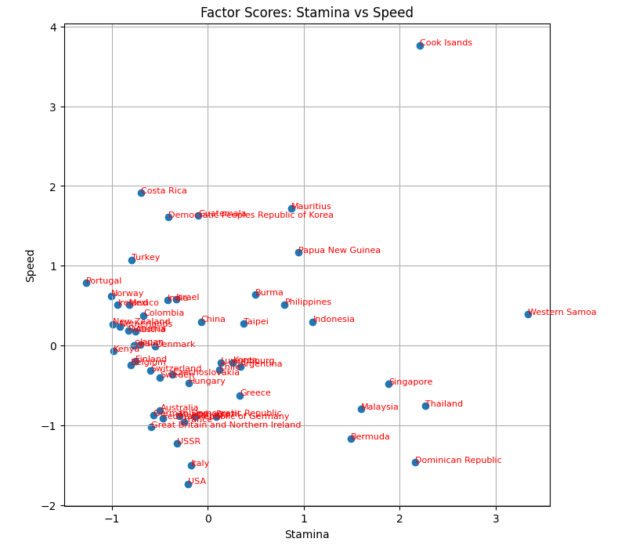
Factor Scores and Visualization
Adding Factor Scores to Data
# Calculate factor scores
factor_scores = fa.transform(athletics)
# Add to original dataframe
data["stamina"] = factor_scores[:, 0]
data["speed"] = factor_scores[:, 1]

Slide 22
Key Takeaways
Factor Analysis provides a powerful framework for understanding complex multivariate relationships and reducing dimensionality while preserving meaningful structure.
Identify latent constructs underlying observed variables
Reduce data complexity while retaining essential information
Rotation improves interpretability through simple structure
Factor scores enable further analysis in reduced dimensions

